Slide 1
Challenges and Opportunities in Sharing Virtual Patients
Dr Angela Miller
St. George’s, University of London
Gabrielle Campbell
Association of American Medical Colleges
International Conference on Virtual Patients
Krakow, Poland
June 6, 2009

Slide 2
Issues to Consider
Copyrights and design
Time and effort
Patient information and consent
Ownership and institutional policy
Jurisdictional differences

Slide 3
What are the rights?
Copyright
Software source code
Design and formatting
Information
Photos, audio, video
Architecture
Design rights – registered and unregistered in specific territories
Aesthetics and creative design

Slide 4
Intellectual Property Rights
Copy
Modify (create derivative works)
Distribute
Publically Display
Publically Perform
Do you have the right to use the material or to share the Virtual Patients you’ve spent time & money creating?

Slide 5
Patient Information & Consent
Informed Consent
Not just an IT way of training – contain real information about real patients
Data protection regulations and respect for patient information
Must be very careful about obtaining proper consent upfront and protecting patient data
Do you have broad enough consent to allow for sharing of the Virtual Patient?

Slide 6
Jurisdiction and Institutions
Every place is different!
Must understand your institution’s policies regarding IPRs and consent, as well as those of others
Copyright laws are not completely harmonized
Consent procedures differ
Do you have the rights and consents to share what you’ve created
– institutionally & legally?

Slide 7
Sharing VPs
If rights aren’t managed, the VP cannot effectively be distributed, repurposed, or shared again (legally)
There IS a solution…

Slide 8
Finding the Common Ground
eVIP: EC funded European collaboration
Eight countries, nine institutions
Dedicated to sharing and repurposing VPs
Needed common framework for IPRs, consent & licensing

Slide 9
Finding the Common Ground
Understanding
Copyright laws for country
Data laws on patient information and consent procedures
Policies for other institutions
Achieving consensus on how VPs will be used
The common ground for licensing – with the creators and the users
Transparency on the managed rights

Slide 10
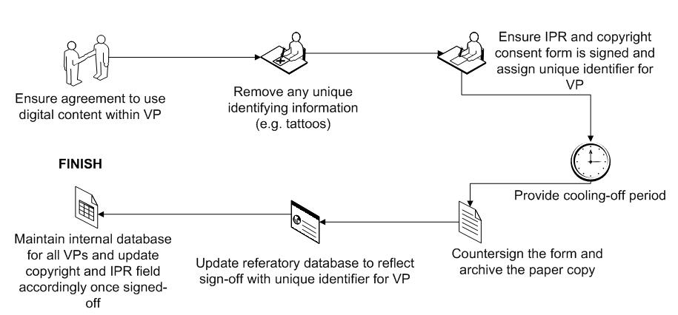

Slide 11
There are obstacles…
But they are NOT insurmountable!
Think ahead
Get the rights and permissions
Know how you want to share your VPs
Upfront attention reduces
obstacles later

Slide 12
Thank you!
Angela Miller
amiller@sgul.ac.uk
Gabrielle Campell
gcampbell@aamc.org

